Slide 1
POLITICS
Why It Matters
How to Be Involved
And
An Overview of the Upcoming Elections
Presentation By:
Cliston Brown
Surplus Line Association of California
Panelists:
Fred Karlinsky
Greenberg Traurig, LLP
Dan Maher
Excess Line Association of
New York
Benjamin McKay
Surplus Line Association of California

Slide 2
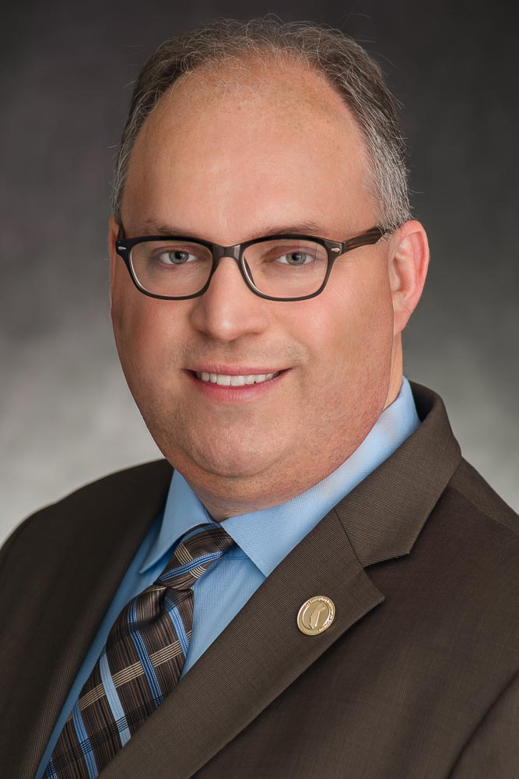
SPEAKER
Cliston Brown
Vice President, Communications, Surplus Line Association of California
Served as chief politics and elections analyst for 2010, 2011 and 2012 election cycles in previous role as Director, Public Affairs at the Property Casualty Insurers Association of America (PCI)
Created and spearheaded PCI’s “Elections Matter” outreach campaign in conjunction with 2012 elections
Served as Director of Communications to a member of the U.S. House of Representatives in Washington, D.C.

Slide 3
OVERVIEW
Presentation
Why politics matters
How to be involved
The upcoming election scene (2015-16)
Group Discussion
Audience to ask questions of panel
Panelists respond to questions and add observations in response to presentation

Slide 4
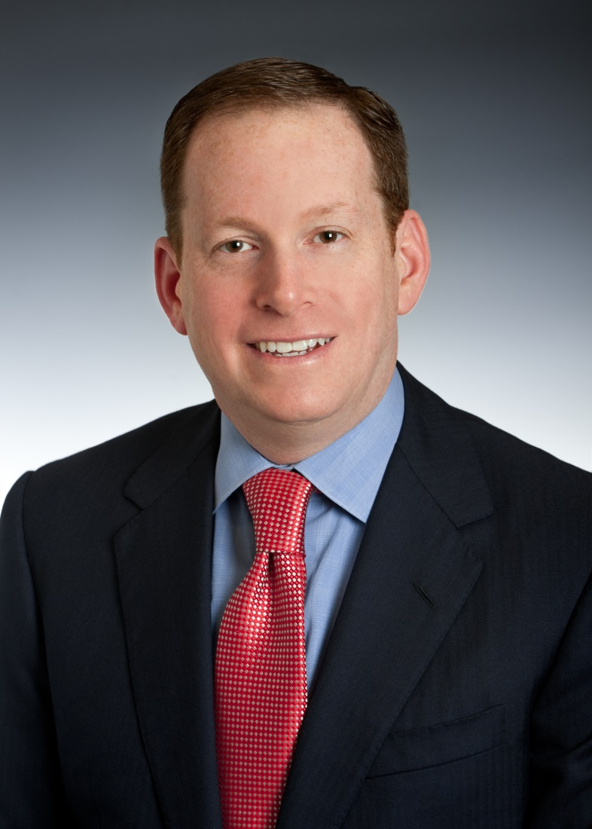
PANELIST
Fred Karlinsky
Shareholder and Co-Chair, Insurance Regulatory and Transactions Practice, Greenberg Traurig, LLP
Appointed by Governor Rick Scott to Florida Supreme Court Judicial Nominating Commission in 2014
Finance Committee member for Florida governor, CFO and attorney general reelection campaigns in 2014
Member of National Finance Committee, Romney 2012
Florida Co-Finance Chair, McCain 2008

Slide 5
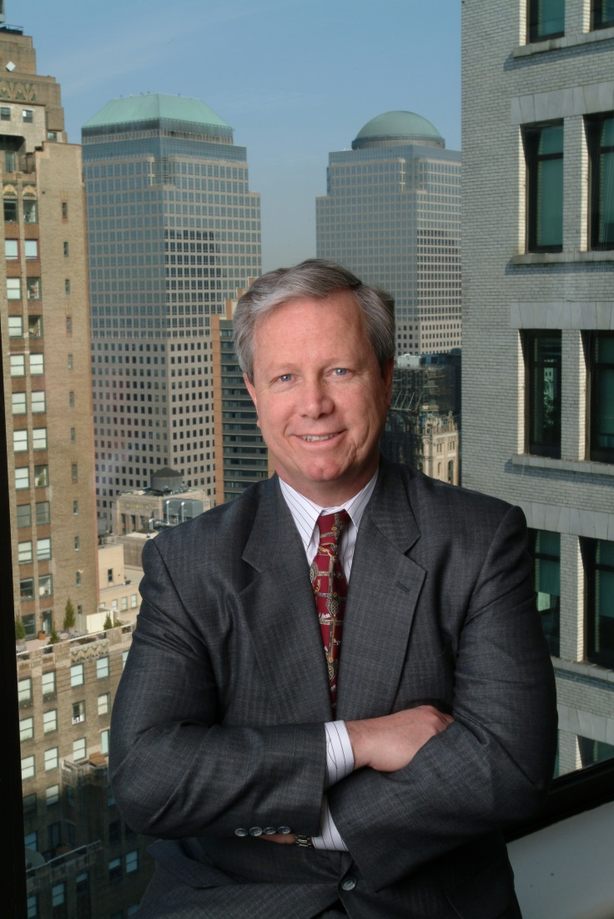
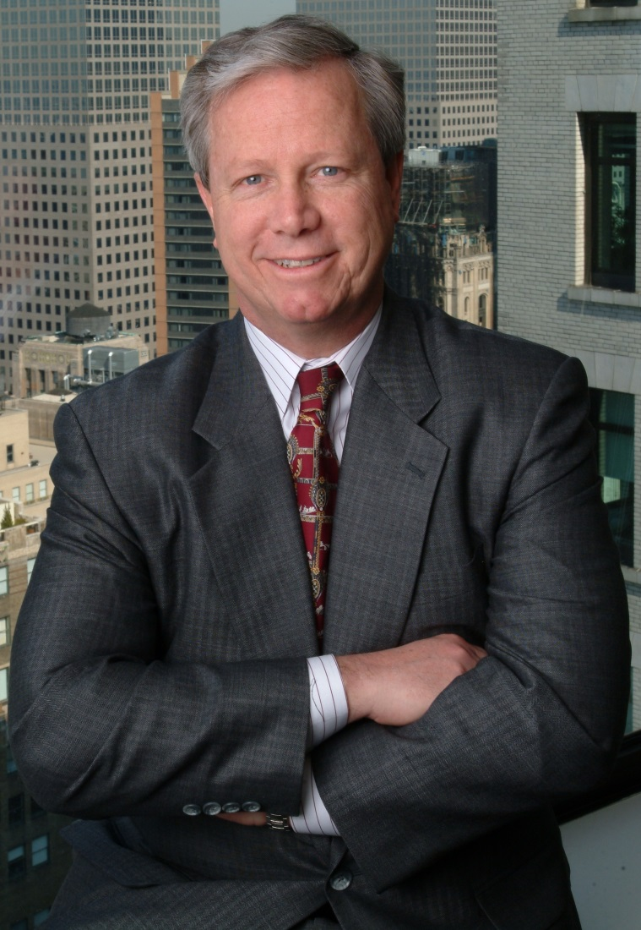
PANELIST
Dan Maher
Executive Director and Chief Operating Officer, Excess Line Association of New York (ELANY)
As a registered lobbyist in the State of New York, has influenced numerous changes to New York State insurance law
Previously Senior Vice President and General Counsel with Lancer Insurance Company
Admitted to the bar in New York and New Jersey

Slide 6
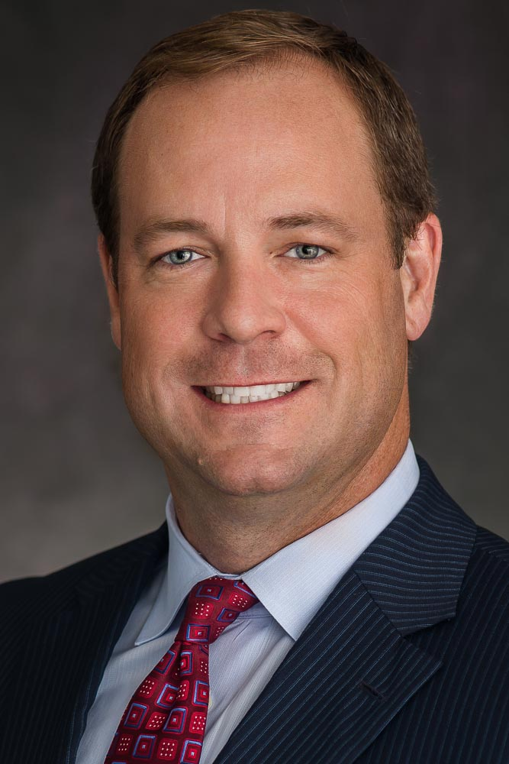
PANELIST
Benjamin McKay
Executive Director, Surplus Line Association of California
Previously Senior Vice President, Federal Government Relations, Property Casualty Insurers Association of America (PCI)
Named one of Washington, D.C.’s Top Association Lobbyists five times by The Hill, a leading political newspaper
Served as Chief of Staff to a member of the U.S. House of Representatives
Youngest Chief of Staff in the history of the Florida Department of State

Slide 7
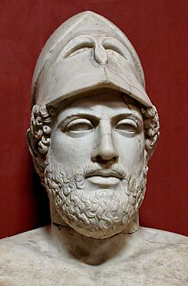
WHY POLITICS MATTERS
“Just because you don’t take an interest in politics doesn’t mean it won’t take an interest in you.”
Quote often ascribed to Pericles, Greek statesman, 5th century BCE

Slide 8
WHY POLITICS MATTERS
In General
Politics is much more pervasive in our daily lives than we may realize
To Business
Political philosophies lead to laws that affect the business climate
To the Surplus Lines Industry
Most political leaders do not know the industry very well, which presents challenges

Slide 9
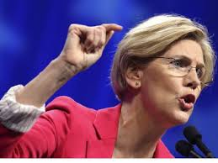
WHY GET INVOLVED?
“If you don’t have a seat at the table, you are probably on the menu.”
U.S. Senator Elizabeth Warren (D-Massachusetts)

Slide 10
HOW TO BE INVOLVED
First, Know the Structure
Legislative: makes laws
Federal—House and Senate
State—House (or Assembly) and Senate (except Nebraska)
Key committees—Financial Services/Banking in U.S. Congress, Insurance/Business/Commerce in the states
Executive: executes laws (and makes some, too)
President, Governors
Cabinet/constitutional offices (including state insurance commissioners—11 of which are elected)
Judicial: interprets laws
Supreme Court (federal and state)
22 state Supreme Courts are elected by the voters
Lower courts (federal and state)

Slide 11
HOW TO BE INVOLVED
Second, Know Your Elected Officials and Political Candidates
Who They Are
Sources: www.house.gov/representatives/find; www.senate.gov/senators/contact
State legislative websites have similar tools
Where They Stand on Issues
Websites of officeholders or candidates
News sources (newspapers, media websites)
Their offices—don’t be afraid to call and ask

Slide 12
HOW TO BE INVOLVED
Third, Interact With Your Elected Officials and Political Candidates
Call
Write
Meet
Volunteer
Donate

Slide 13
THE PERSONAL TOUCH
Percentage of Congressional Staffers Who Say The Following Methods Impact Elected Officials’ Votes:
In-Person Constituent Visits: 97% (46% a lot)
Contact from Constituent Who Represents Other Constituents: 96% (36% a lot)
Postal Letters: 90% (20% a lot)
Individual E-Mails: 88% (19% a lot)
Phone Calls: 86% (14% a lot)
Comments During Telephone Town Hall: 85% (17% a lot)
SOURCE: 2011 survey of 260 U.S. House and Senate staff by the Congressional Management Foundation

Slide 14
WHAT DOESN’T WORK
Form letters, postcards and comments on social media sites are thought to have “a lot” of influence on elected officials’ votes by only 1% of Congressional staffers surveyed
Form faxes: 0% (Individualized faxes: 8%)
53% of staffers surveyed said most advocacy campaigns that produced identical form messages “are sent without the constituent’s knowledge or approval.”
SOURCE: 2011 survey of 260 U.S. House and Senate staff by the Congressional Management Foundation

Slide 15
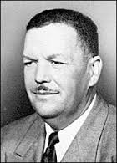
VOTING MATTERS
“If you don’t vote, you don’t count.”
Vernon Dahmer (1908-66)
President, Forrest County, Mississippi NAACP

Slide 16
VOTING MATTERS
1 vote: Margin of victory in 2008 Alaska legislative race (out of 10,035)
4 votes: Margin of victory in 1984 U.S. House race in southwestern Indiana (out of 233,286)
21 votes: Margin of victory in 1994 U.S. House race in eastern Connecticut (out of 186,071)
48 votes: Margin of victory in 1964 U.S. Senate race in Nevada (out of 134,624)
133 votes: Margin of victory in 2004 governor’s race in Washington (out of 2,810,058)

Slide 17
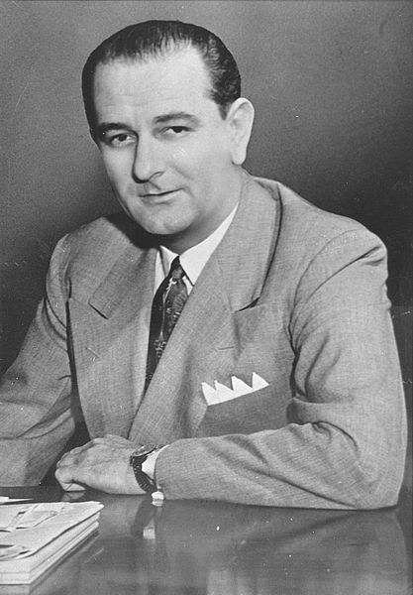
VOTING MATTERS
87 votes
The margin of victory for future U.S. President Lyndon Johnson in the 1948 Democratic primary in the U.S. Senate race in Texas (out of 988,295)

Slide 18
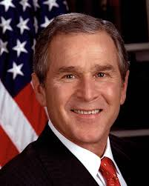
VOTING MATTERS
537 votes
The margin of victory for George W. Bush in Florida in the 2000 presidential race (out of 5,962,657)
Winning Florida’s 25 electors gave Bush 271 electoral votes
(270 required to win)

Slide 19
UPCOMING ELECTIONS
2015
Races for governor, both legislative chambers and insurance commissioner in Louisiana, Mississippi
Race for governor in Kentucky
Races for both legislative chambers in Virginia
Races for Assembly only in New Jersey
Judicial races in LA, NY, PA, WA

Slide 20
UPCOMING ELECTIONS
2016
President
All 435 U.S. House seats and 34 of 100 U.S. Senate seats
Governors in 12 states (DE, IN, MO, MT, NH, NC, ND, UT, VT, WA, WV, plus special election in Oregon)
Legislatures in most states
Insurance commissioners in 5 states (DE, MT, NC, ND, WA)

Slide 21
2016 PRESIDENTIAL RACE
Calendar
Iowa caucuses and New Hampshire primary expected to take place in January
Caucuses and primaries to run through June
Republican convention July 18-21, 2016 in Cleveland
Democratic convention July 25-28, 2016 in Philadelphia
Election Day: Tuesday, Nov. 8, 2016

Slide 22
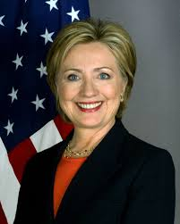
2016 PRESIDENTIAL RACE
The Democrats
Hillary Clinton
Prohibitive frontrunner
Huge primary polling leads
Also running:
Sen. Bernie Sanders (VT)
Former Gov. Lincoln Chafee (RI)
Former Gov. Martin O’Malley (MD)
Exploring bid:
Former Sen. Jim Webb (VA)
No overt moves made so far by Warren, Biden

Slide 23
2016 PRESIDENTIAL RACE
The Republicans
Declared candidates:
Gov. Bobby Jindal (LA)
Sen. Ted Cruz (TX)
Sen. Lindsey Graham (SC)
Sen. Rand Paul (KY)
Sen. Marco Rubio (FL)
Former Gov. Jeb Bush (FL)
Former Gov. Mike Huckabee (AR)
Former Gov. George Pataki (NY)
Former Gov. Rick Perry (TX)
Former Sen. Rick Santorum (PA)
Former neurosurgeon Ben Carson
Former IRS Comm. Mark Everson
Former HP CEO Carly Fiorina
Businessman Donald Trump
Expected to Run
Gov. Chris Christie (NJ)
Gov. John Kasich (OH)
Gov. Scott Walker (WI)
Considering Bids
Former Gov. Bob Ehrlich (MD)
Former Gov. Jim Gilmore (VA)

Slide 24
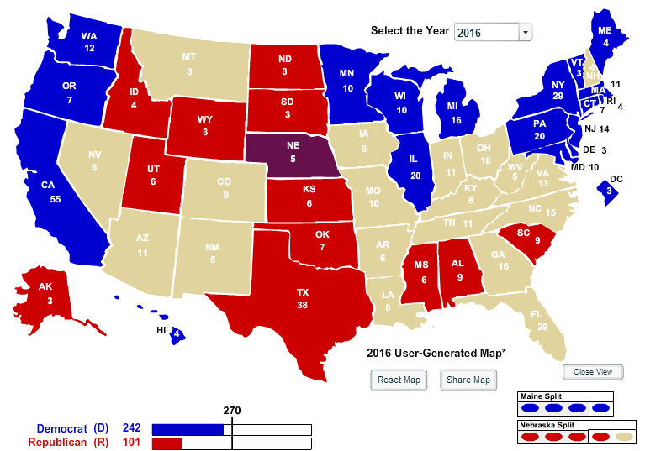
ADVANTAGE: DEMOCRATS?
If all states that have voted for the same party in the last six elections remain the same, the Democrats start out with 242 of the 270 electoral votes required to win.

Slide 25
ADVANTAGE: GOP?
Since 1948, there have been six elections in which either party had an opportunity to win the White House for a third consecutive term. The incumbent party has lost five of these six elections.
YEAR | INCUMBENT PARTY (PRESIDENT) | INCUMBENT PARTY’S PRESIDENTIAL CANDIDATE | RESULT
1960 | Republican (Dwight Eisenhower) | Richard Nixon (Vice President) | LOST
1968 | Democratic (Lyndon Johnson) | Hubert Humphrey (Vice President) | LOST
1976 | Republican (Gerald Ford) | Gerald Ford (President) | LOST
1988 | Republican (Ronald Reagan) | George H.W. Bush (Vice President) | WON
2000 | Democratic (Bill Clinton) | Al Gore (Vice President) | LOST
2008 | Republican (George W. Bush) | John McCain (Senator) | LOST

Slide 26
2016 PRESIDENTIAL RACE
Key States
Florida
29 electoral votes
Decided by 0.88% in 2012 (Obama)
Ohio
18 electoral votes
Decided by 2.98% in 2012 (Obama)
North Carolina
15 electoral votes
Decided by 2.04% in 2012 (Romney)
Virginia
13 electoral votes
Decided by 3.88% in 2012 (Obama)
Other States To Watch:
Pennsylvania (20 electoral votes), Minnesota (10), Wisconsin (10),
Colorado (9), Iowa (6), Nevada (6), New Hampshire (4)
All won by Obama in 2012
All decided by 5%-7%
Georgia (16 electoral votes), Arizona (11)
Both won by Romney in 2012 and by GOP in at least four straight elections
Democrats hope demographic changes make both states competitive

Slide 27
2016 CONGRESSIONAL
Current Situation
U.S. Senate
Republicans control, 54-46
Democrats need net gain of 4 seats if they retain White House (Vice President is tiebreaker)
Democrats need net gain of 5 seats if Republicans win White House
No party controlling the Senate prior to an election has lost its majority in a year in which it has won the White House
U.S. House of Representatives
Republicans control, 247-188
Democrats need net gain of 30 seats

Slide 28
2016 CONGRESSIONAL
Key Targets: U.S. Senate
Republicans defending 24 seats
16 considered safe at this time
6 incumbents possibly vulnerable (IL, OH, PA, NC, WI, NH)
2 open seats (FL, IN)
Democrats defending 10 seats
6 considered safe at this time
1 incumbent possibly vulnerable (CO)
3 open seats (CA, MD, NV)

Slide 29
2016 CONGRESSIONAL
Potential Key Targets: U.S. House
5 races undecided a week after 2014 election
Democrats won 4 of those 5 (CA-7, CA-16, CA-26, NY-25)
GOP won Arizona’s 2nd District by 133 votes
26 districts that voted for Obama in 2012 are currently represented by Republicans
6 in New York (Districts 1, 2, 11, 19, 21, 24)
3 in Florida (Districts 13, 26, 27)
2 each in California (10, 21), Illinois (10, 12), Iowa (1, 3), Minnesota (2, 3), Nevada (3, 4) and New Jersey (2, 3)
CO-6, ME-2, NH-1, VA-2, WA-8
5 districts that voted for Romney in 2012 are currently represented by Democrats
2 in Florida (Districts 2, 18)
AZ-1, MN-7, NE-2

Slide 30
2016 CONGRESSIONAL
States With Largest Numbers of Potential U.S. House Target Races
New York—7
California—5
Florida—5
Also has open-seat Senate race
Also expected to be closely contested by Democratic, GOP presidential nominees

Slide 31
2016 LEGISLATURES IN PLAY
Arizona Senate (17-13 R)
Colorado House (34-31 D)
Colorado Senate (18-17 R)
Iowa Senate (26-24 D)
Kentucky House (54-46 D)
Maine Senate (21-14 R)
Minnesota House (72-62 R)
Minnesota Senate (39-28 D)
Nevada Assembly (27-15 R)
Nevada Senate (11-10 R)
New Hampshire House (239-160 R)
New Hampshire Senate (14-10 R)
New Mexico House (37-33 R)
New Mexico Senate (24-18 D)
New York Senate (32-31 R, but five Democrats belong to “Independent Democratic Conference” )
Washington House (51-47 D)
Washington Senate (25-24 R, but 1 Democrat also caucuses with GOP)

Slide 32
PANEL DISCUSSION

